Slide 1


&
up running
-- w/--
progressive
|
web apps
Nik Molnar | @nikmd23

Slide 2

reach vs. richness There are 10 kinds of people in the world. Those that understand binary, and those that don’t.
?


2004
Global
1998
2008



1992
Local
Text UI
Graphical UI
Natural UI

Slide 3






‘web’ app models #titanic { float: none; bottom: 0; }
Adobe AIR
Palm WebOS
Apache Cordova
Microsoft WinJS
Electron
W3C Widgets

Slide 4
progressive web apps ["hip", "hip"] // first person to figure this out and shout it out loud wins
1





responsive
work offline
app like
fresh
safe
2

⬄


3
discoverable
re-engageable
installable
linkable

Slide 5
1

work offline.

Slide 6
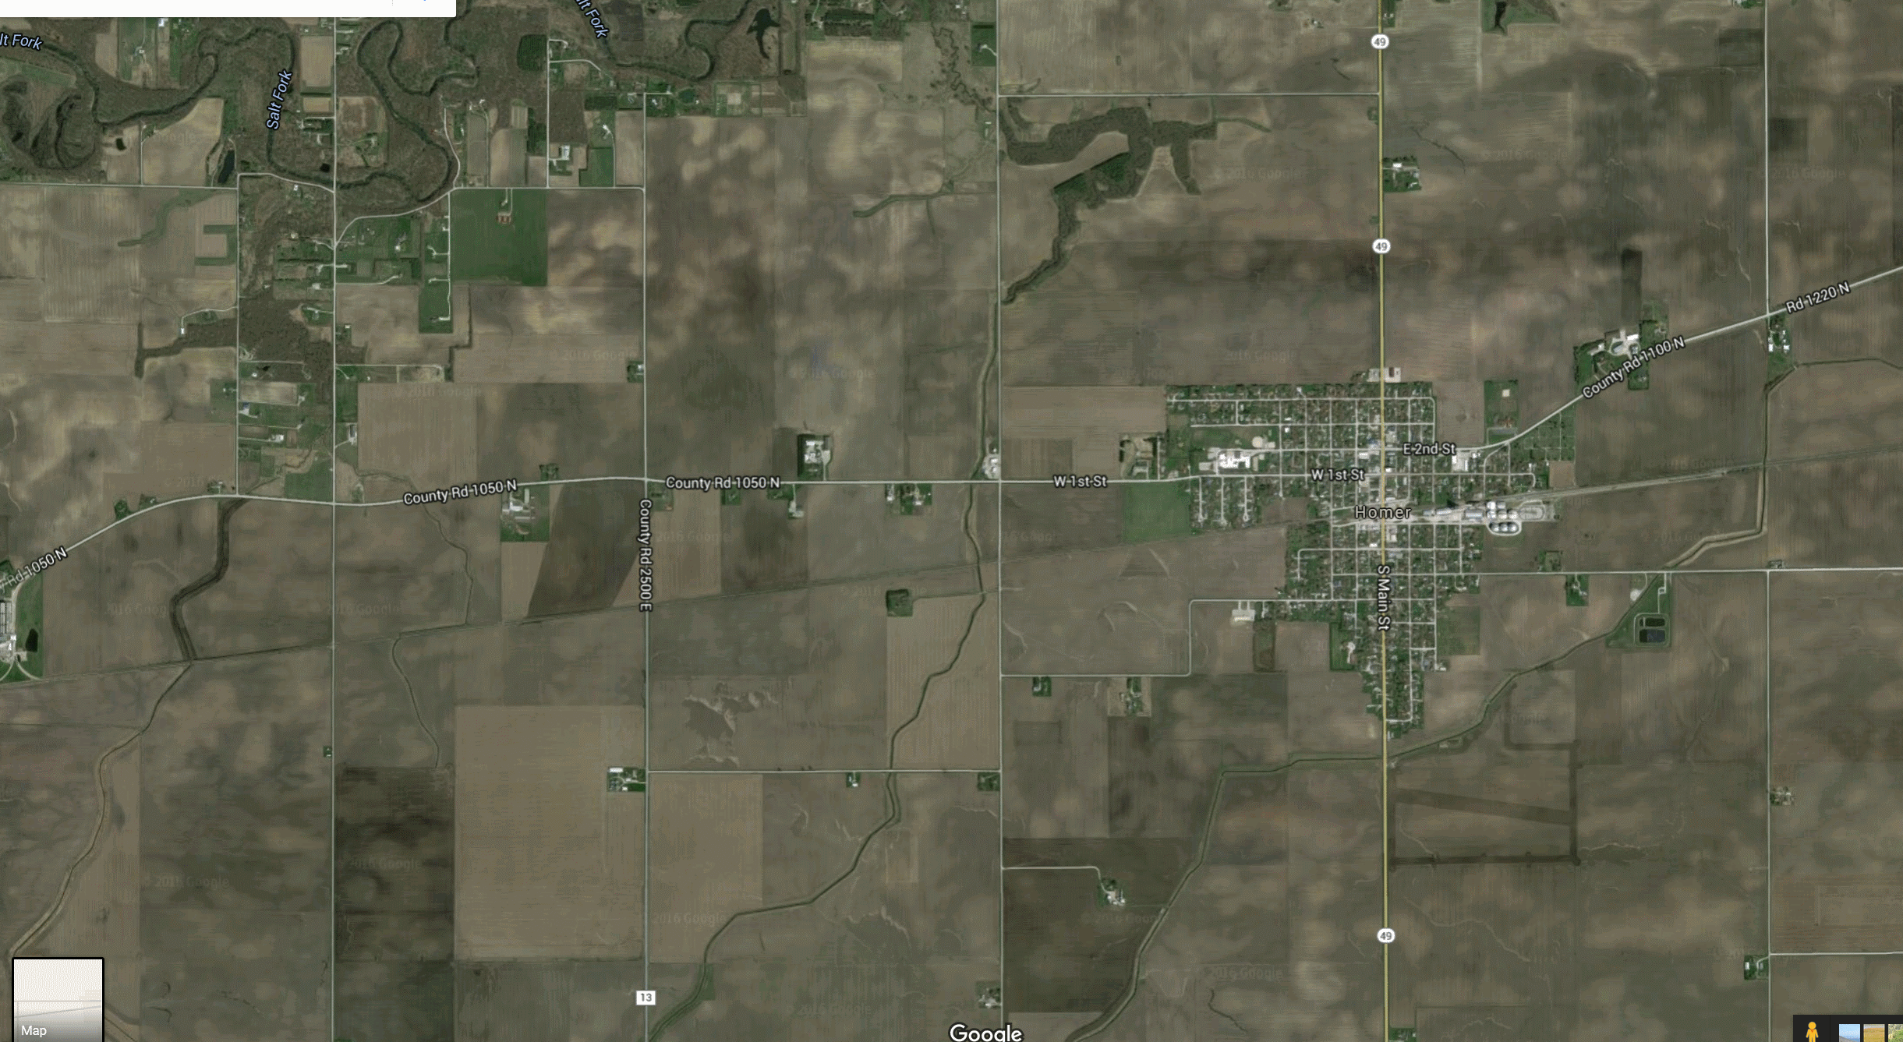


Notes:
Tell story of how on On June 4th at the homer soda festival I was going to use my app
Let me show you the app

Slide 7
connectively challenged This color is #BADA55.
❒



transport
crowds
inside
lie-fi

Slide 8
service worker overview Finally, this guy gets to some real content!





Slide 9
service worker overview Finally, this guy gets to some real content!






Slide 10
service worker overview Finally, this guy gets to some real content!







Slide 11
2

installable.

Slide 12
app manifest
1f u c4n r34d th1s u r34lly n33d t0 g0 out51d3.
<link rel="manifest" href="/manifest.json">

Slide 13
app manifest
1f u c4n r34d th1s u r34lly n33d t0 g0 out51d3.
<link rel="manifest" href="/manifest.json">
{
"name": "SodaPopped",
"short_name": "SodaPopped",
"start_url": "/",
"background_color": "#3498DB",
"theme_color": "#34495E",
"orientation": "portrait-primary",
"display": "standalone",
"icons": [{
"src": "/path/to/image.ext",
"type": "image/png",
"sizes": "192x192"
}]
}

Slide 14
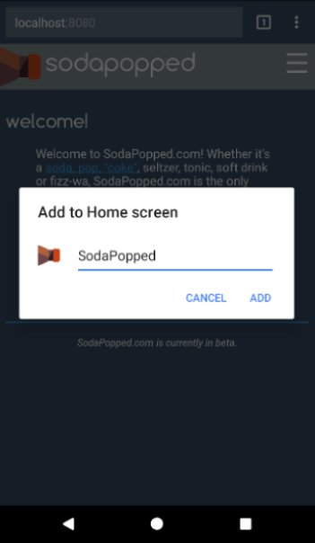
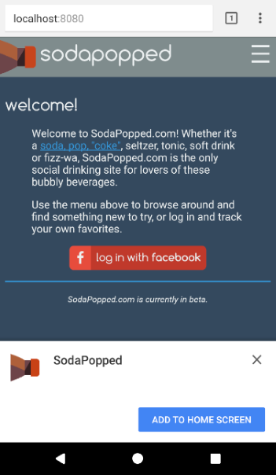
app manifest
1f u c4n r34d th1s u r34lly n33d t0 g0 out51d3.
<link rel="manifest" href="/manifest.json">
{
"name": "SodaPopped",
"short_name": "SodaPopped",
"start_url": "/",
"background_color": "#3498DB",
"theme_color": "#34495E",
"orientation": "portrait-primary",
"display": "standalone",
"icons": [{
"src": "/path/to/image.ext",
"type": "image/png",
"sizes": "192x192"
}]
}
Identity

Slide 15
app manifest
1f u c4n r34d th1s u r34lly n33d t0 g0 out51d3.
<link rel="manifest" href="/manifest.json">
{
"name": "SodaPopped",
"short_name": "SodaPopped",
"start_url": "/",
"background_color": "#3498DB",
"theme_color": "#34495E",
"orientation": "portrait-primary",
"display": "standalone",
"icons": [{
"src": "/path/to/image.ext",
"type": "image/png",
"sizes": "192x192"
}]
}
Presentation

Slide 16
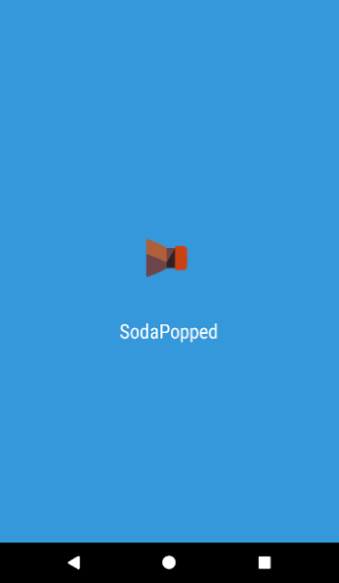
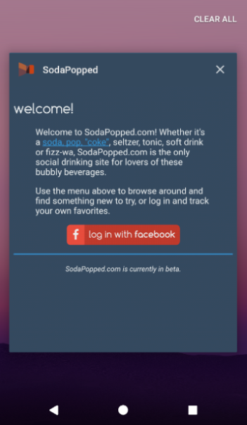
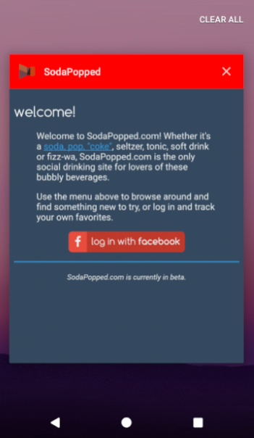
app manifest
1f u c4n r34d th1s u r34lly n33d t0 g0 out51d3.
<link rel="manifest" href="/manifest.json">
{
"name": "SodaPopped",
"short_name": "SodaPopped",
"start_url": "/",
"background_color": "#3498DB",
"theme_color": "#34495E",
"orientation": "portrait-primary",
"display": "standalone",
"icons": [{
"src": "/path/to/image.ext",
"type": "image/png",
"sizes": "192x192"
}]
}
Presentation

Slide 17
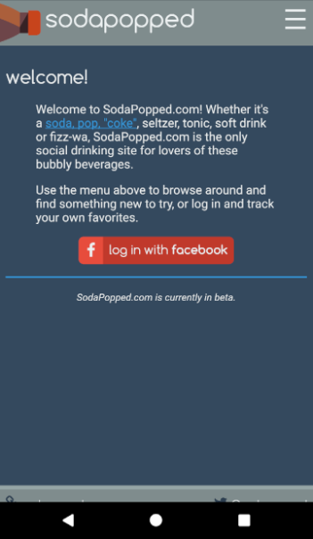
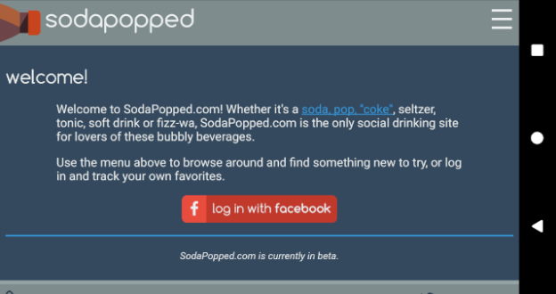
app manifest
1f u c4n r34d th1s u r34lly n33d t0 g0 out51d3.
<link rel="manifest" href="/manifest.json">
{
"name": "SodaPopped",
"short_name": "SodaPopped",
"start_url": "/",
"background_color": "#3498DB",
"theme_color": "#34495E",
"orientation": "portrait-primary",
"display": "standalone",
"icons": [{
"src": "/path/to/image.ext",
"type": "image/png",
"sizes": "192x192"
}]
}
Presentation

Slide 18
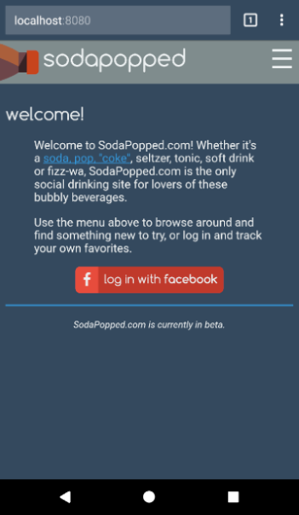
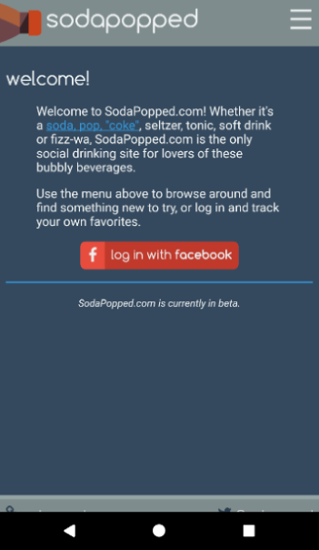
app manifest
1f u c4n r34d th1s u r34lly n33d t0 g0 out51d3.
<link rel="manifest" href="/manifest.json">
{
"name": "SodaPopped",
"short_name": "SodaPopped",
"start_url": "/",
"background_color": "#3498DB",
"theme_color": "#34495E",
"orientation": "portrait-primary",
"display": "standalone",
"icons": [{
"src": "/path/to/image.ext",
"type": "image/png",
"sizes": "192x192"
}]
}
Presentation

Slide 19
app manifest
1f u c4n r34d th1s u r34lly n33d t0 g0 out51d3.
<link rel="manifest" href="/manifest.json">
{
"name": "SodaPopped",
"short_name": "SodaPopped",
"start_url": "/",
"background_color": "#3498DB",
"theme_color": "#34495E",
"orientation": "portrait-primary",
"display": "standalone",
"icons": [{
"src": "/path/to/image.ext",
"type": "image/png",
"sizes": "192x192"
}]
}
Icons


Slide 20
install banner requirements A common programming solution is to use threads. But then, two ‘llyou hav erpoblesm.
secure site with green lock icon
registered service worker
offline experience
app manifest with:
name
short_name
icons at least 144x144
start_url
display = standalone | fullscreen

Slide 21
3
⬄
re-engageable.

Slide 22




web push overview Oct 31 == Dec 25, so Halloween is Christmas.





configure push


Slide 23
web push overview Oct 31 == Dec 25, so Halloween is Christmas.





configure push
send message


Slide 24
web push overview Oct 31 == Dec 25, so Halloween is Christmas.



⬄
1


configure push
send message

receive message


Slide 25
4
✴
tools.

Slide 26





lighthouse
These jokes aren’t bad. They’re in “beta”.
built by Google
open source
Chrome extension
npm module


Slide 27
reach vs. richness Fun Fact: The word “algorithm” was coined in tribute to Al Gore’s contribution to computer science.
future is
promising


Global



Local
Text UI
Graphical UI
Natural UI

Slide 28

thanks!
questions & answers
Send complaints to: trash@molnar.com

nikmd23
·
nikcodes.com
pluralsight
https://nikcodes.com/pwa-fundamentals

